Slide 1
Dimensionality Reduction
Haiqin Yang

Slide 2
Outline
Dimensionality reduction vs. manifold learning
Principal Component Analysis (PCA)
Kernel PCA
Locally Linear Embedding (LLE)
Laplacian Eigenmaps (LEM)
Multidimensional Scaling (MDS)
Isomap
Semidefinite Embedding (SDE)
Unified Framework

Slide 3
Dimensionality Reduction vs. Manifold Learning
Interchangeably
Represent data in a low-dimensional space
Applications
  Data visualization
  Preprocessing for supervised learning

Slide 4
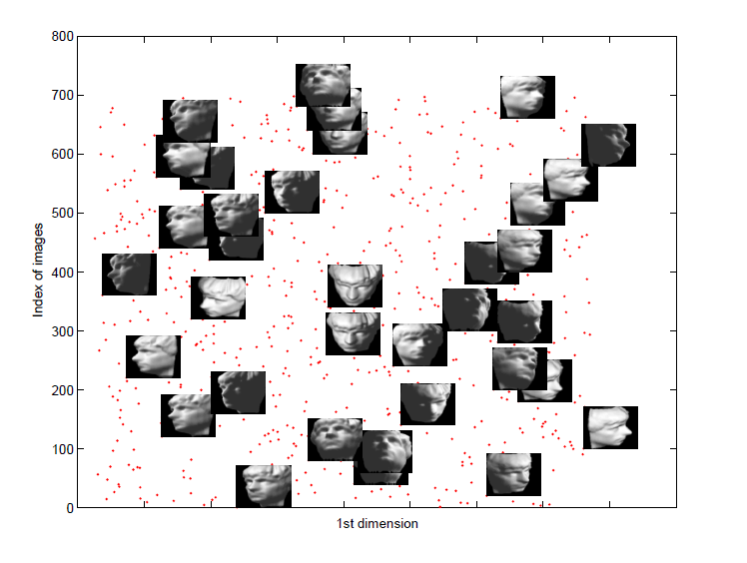
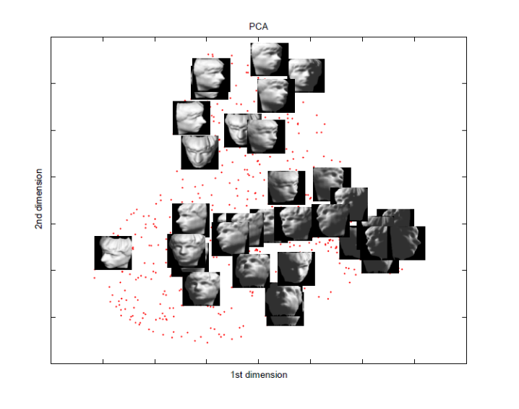
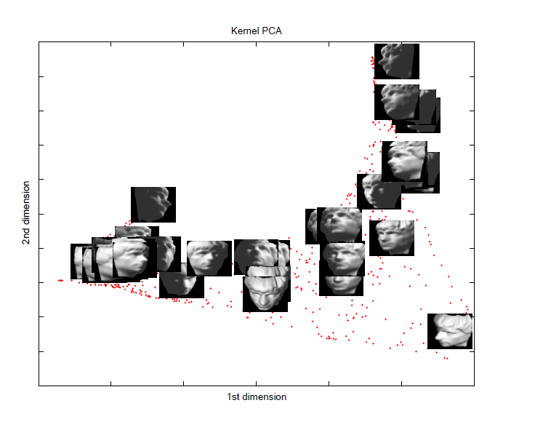
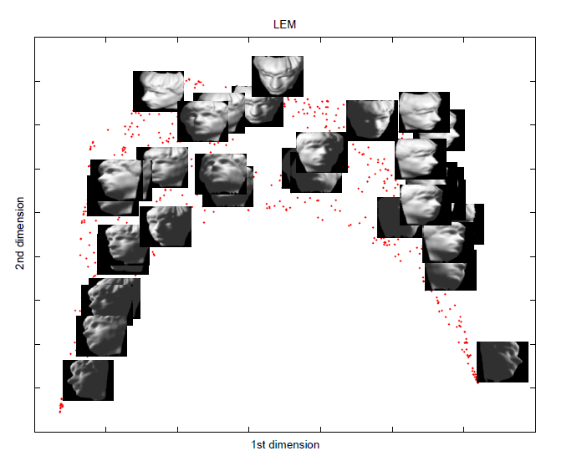
Examples

Slide 5
Models
Linear methods
  Principal component analysis (PCA)
  Multidimensional scaling (MDS)
  Independent component analysis (ICA)
Nonlinear methods
  Kernel PCA
  Locally linear embedding (LLE)
  Laplacian eigenmaps (LEM)
  Semidefinite embedding (SDE)

Slide 6
Principal Component Analysis (PCA)
History: Karl Pearson, 1901
Find projections that capture the largest amounts of variation in data
Find the eigenvectors of the covariance matrix, and these eigenvectors define the new space
x₂
e
x₁

Slide 7
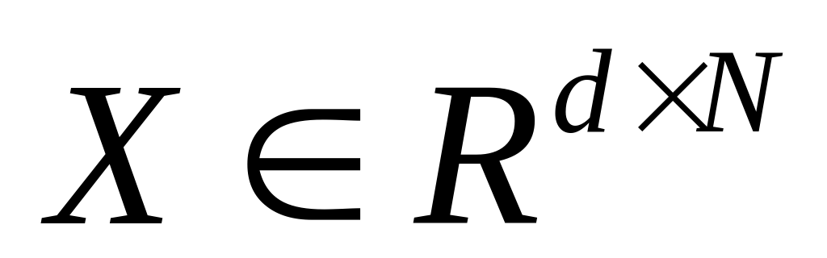
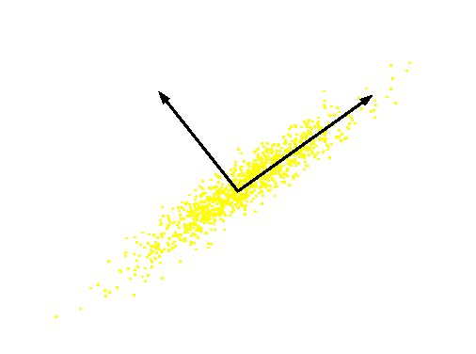
PCA
Definition: Given a set of data , find the principal axes are those orthonormal axes onto which the variance retained under projection is maximal
PC 2
Original Variable B
PC 1
Original Variable A

Slide 8
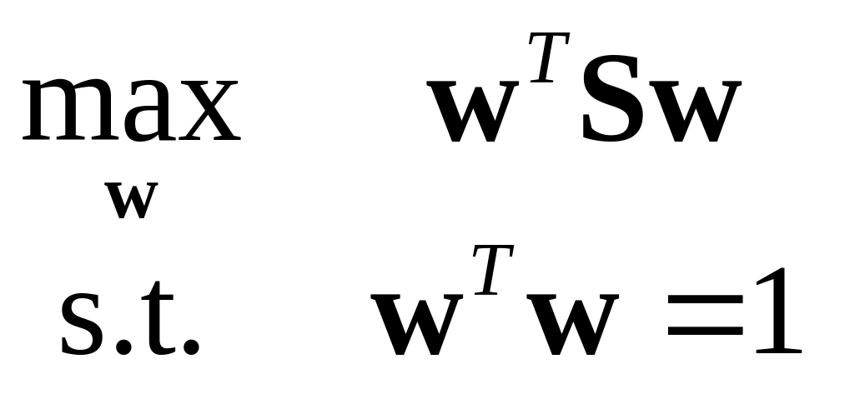
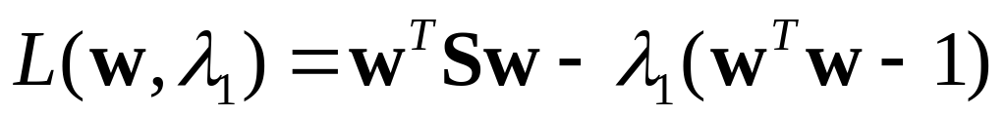
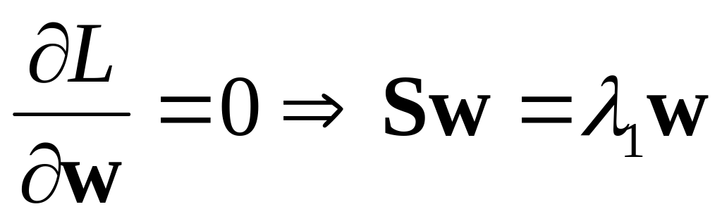
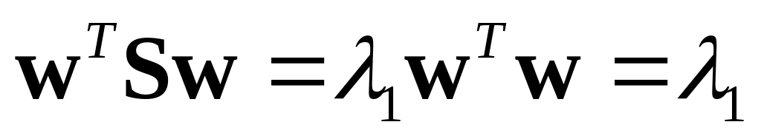
Formulation
Variance on the first dimension
  var(U₁)=var(w^{T}X)=w^{T}Sw
  S: covariance matrix of X
Objective: the variance retains the maximal
Formulation
Solving procedure
  Construct Langrangian
  Set the partial derivative on to zero
  As w ≠ 0 then w must be an eigenvector of S with eigenvalue λ₁

Slide 9
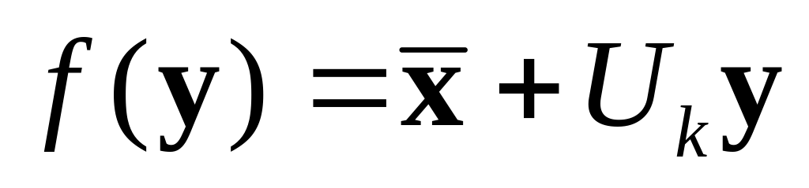
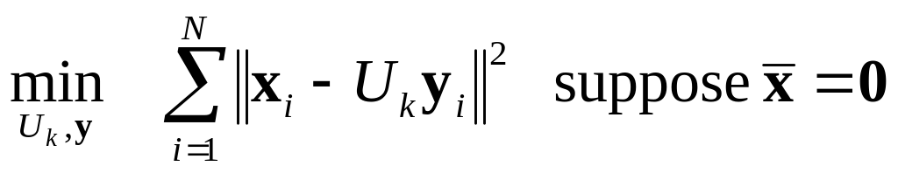
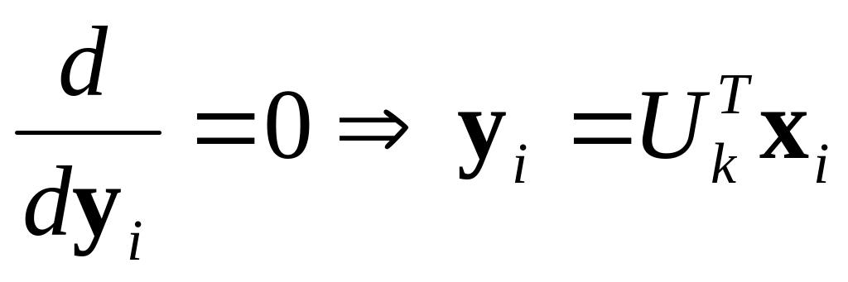
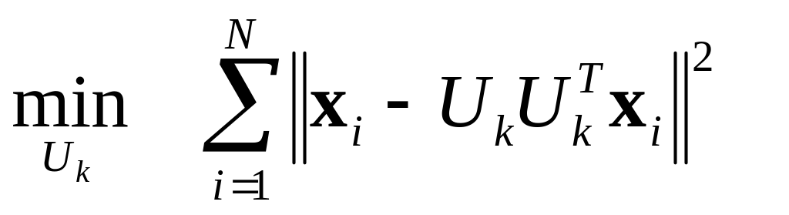

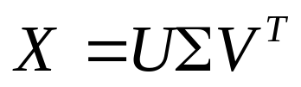
PCA: Another Interpretation
A rank-k linear approximation model
Fit the model with minimal reconstruction error
Optimal condition
Objective
can be expressed as SVD of X,

Slide 10
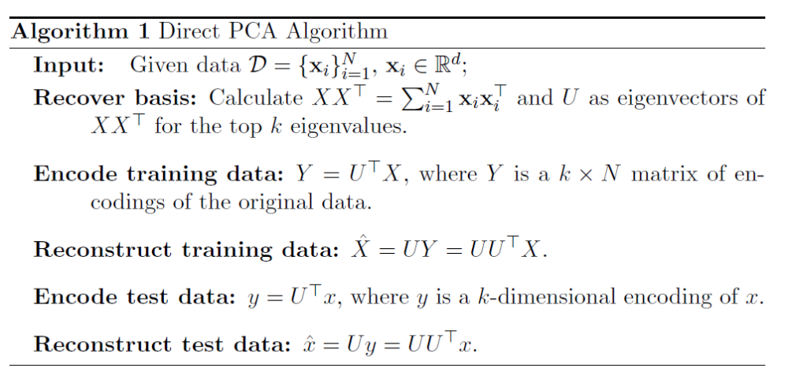
PCA: Algorithm

Slide 11


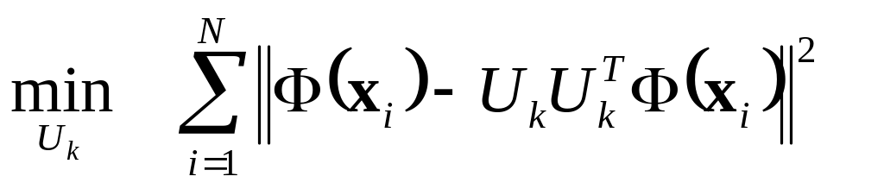


Kernel PCA
History: S. Mika et al, NIPS, 1999
Data may lie on or near a nonlinear manifold, not a linear subspace
Find principal components that are nonlinearly to the input space via nonlinear mapping
Objective
Solution found by SVD:
U contains the eigenvectors of

Slide 12
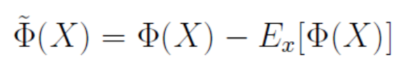
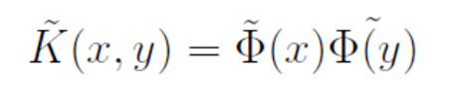
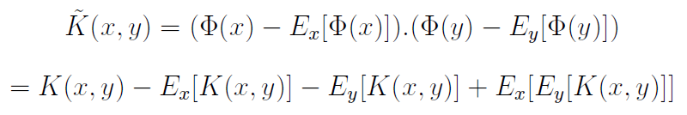
Kernel PCA
Centering
Issue: Difficult to reconstruct

Slide 13
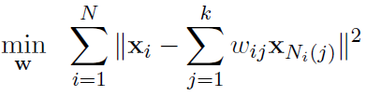
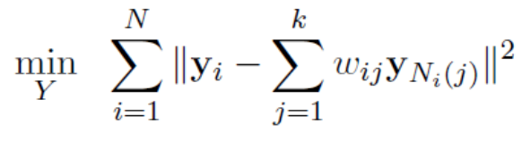

Locally Linear Embedding (LLE)
History: S. Roweis and L. Saul, Science, 2000
Procedure
  Identify the neighbors of each data point
  Compute weights that best linearly reconstruct the point from its neighbors
  Find the low-dimensional embedding vector which is best reconstructed by the weights determined in Step 2
Centering Y with unit variance

Slide 14
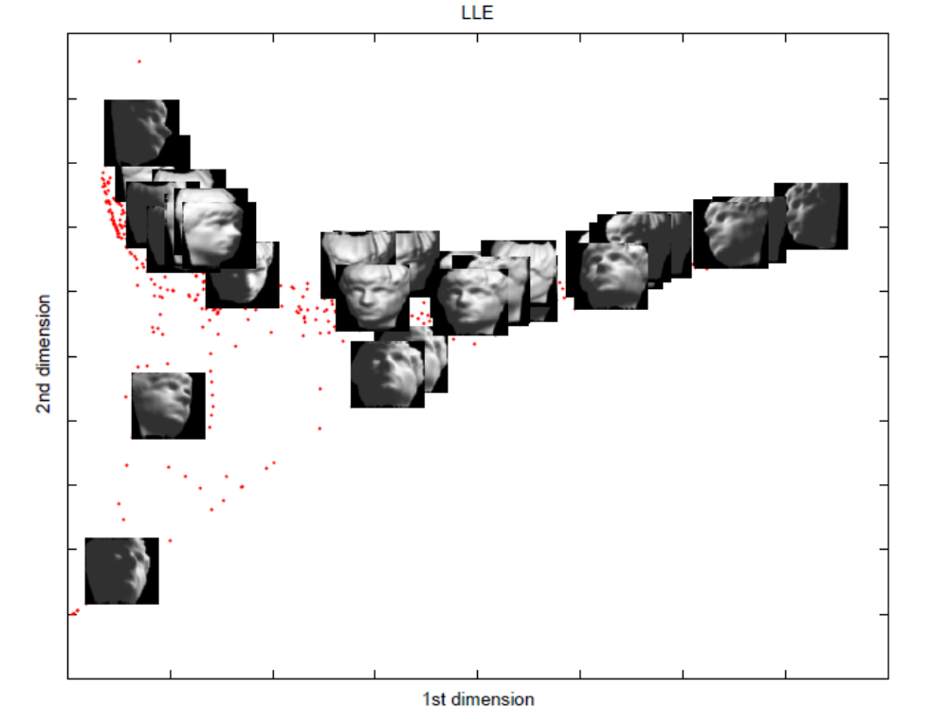
LLE Example

Slide 15
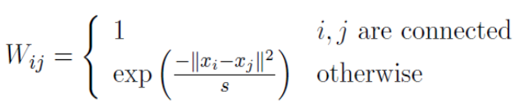
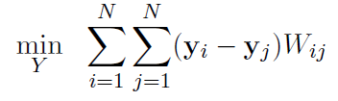

Laplacian Eigenmaps (LEM)
History: M. Belkin and P. Niyogi, 2003
Similar to locally linear embedding
Different in weights setting and objective function
  Weights
  Objective

Slide 16
LEM Example

Slide 17
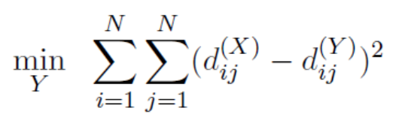



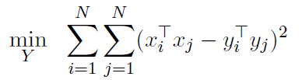
Multidimensional Scaling (MDS)
History: T. Cox and M. Cox, 2001
Attempts to preserve pairwise distances
Different formulation of PCA, but yields similar result form
Transformation

Slide 18
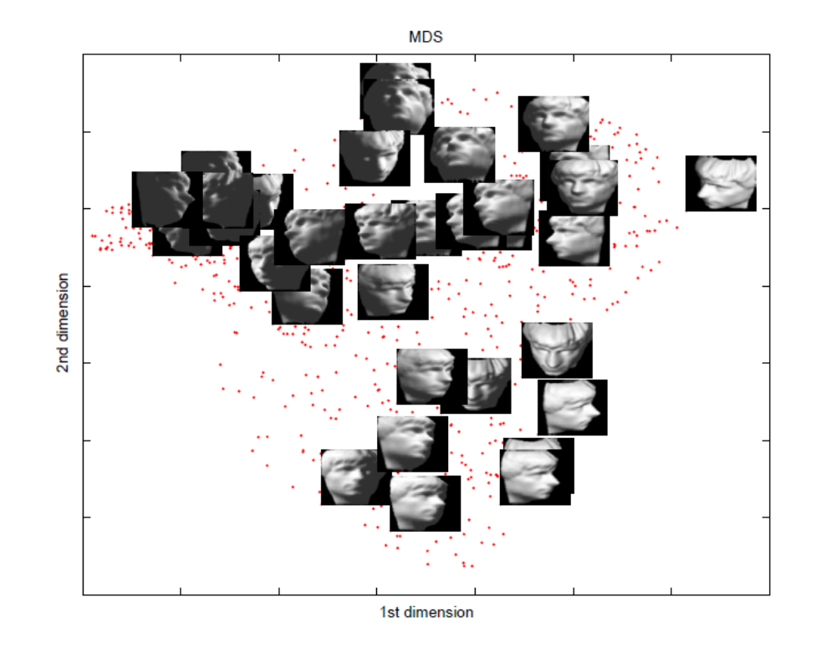
MDS Example

Slide 19
Isomap
History: J. Tenenbaum et al, Science 1998
A nonlinear generalization of classical MDS
Perform MDS, not in the original space, but in the geodesic space
Procedure-similar to LLE
  Find neighbors of each data point
  Compute geodesic pairwise distances (e.g., shortest path distance) between all points
  Embed the data via MDS

Slide 20
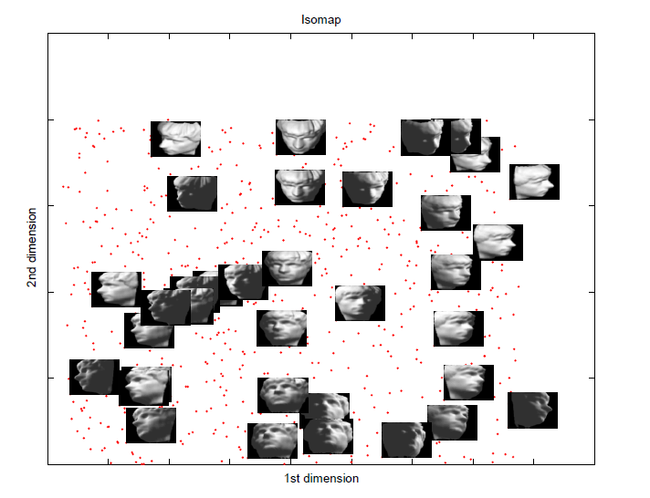
Isomap Example

Slide 21


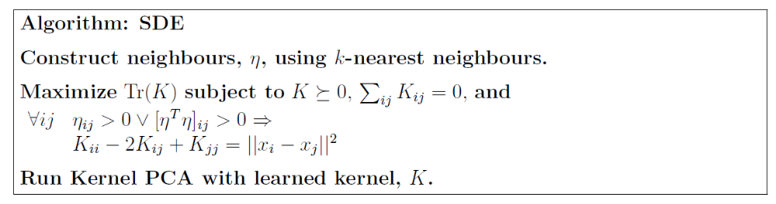
Semidefinite Embedding (SDE)
History: K. Weinberger and L. Saul, ICML, 2004
A variation of kernel PCA
Criteria: if both points are neighbor, or common neighbors of another point
Procedure

Slide 22
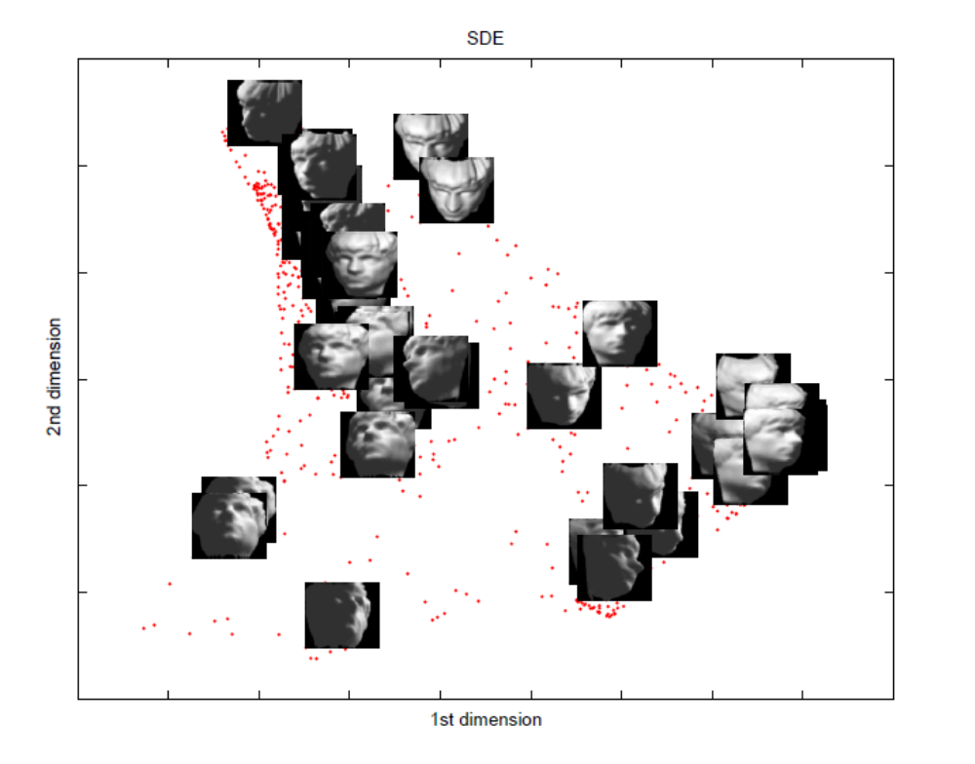
SDE Example

Slide 23
Unified Framework
All previous methods can be cast as kernel PCA
Achieve by adopting different kernel definitions

Slide 24
Summary
Seven dimensional reduction methods
Unified framework: kernel PCA

Slide 25
Reference
Ali Ghodsi. Dimensionality Reduction: A Short Tutorial. 2006

